Slide 1
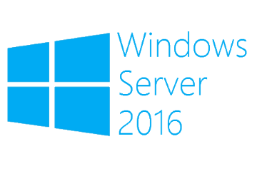
Hyper-V Replica
Megaseries

Slide 2
Info
Replica is a technology that replicates a virtual machine to another Hyper-V host to have a copy of it in case of a disaster
Replication can be done at a time interval from the following: 30 seconds, 5 minutes and 15 minutes
Additional recovery points can also be saved (number of recovery points can be set); VSS snapshots can also be taken
Failovers to the replica ca be done and depending on the scenarios they can be: Test failovers, Planned failovers and Unplanned failovers

Slide 3
Failover types
Test failover: The primary machine remains in the running state. On the replica host a copy of the replica VM is made and that one is started in another network than the productive one
Planned failover: In this scenario we know that the failover will be done. The primary machine is shut down and the failover is started. After it is done, the replication can also be reversed. No data is lost in this scenario
Unplanned failover: This scenario is used when the primary host is unavailable. Data can be lost.

Slide 4
Extended replication
New in 2012 R2 is the extended replication functionality
You can replicate the replica to a third Hyper-V server
The replication intervals possible to use are 5 minutes and 15 minutes but it cannot be smaller than the interval used between the first 2 servers
One possible scenario might be: you replicate the machines in your environment to a second Hyper-V server and from that one you also replicate the VM to a service provider to have a backup copy

Slide 5

https://www.youtube.com/channel/UCcZ-jLbPwNr8E_v9-65n8Iw https://github.com/itknowledge4

